Slide 1
Front End Engineering-I Project
Team Details:
Pratham Jindal (2310992260) [TEAM LEADER]
Prerit Siwach (2310992261)
Prithvi Thakur (2310992262)
Faculty Coordinator: Dr. Chetna Kaushal
:
Chitkara University Institute of Engineering and Technology,
Chitkara University, Punjab

Slide 2
Table of Contents
Introduction
Problem Statement
Technical Details
Key Features
Project Highlights
Conclusion
References/Links used

Slide 3
Introduction
TITLE OF PROJECT –> TO-DO LIST
TEAM MEMBERS ->
Pratham Jindal (2310992260)
Prerit Siwach (2310992261)
Prithvi Thakur (2310992262)
Overview of Project ->
The purpose of a to-do list is to help the individual stay organized as when he/she writes his/her tasks in a list, they seem more manageable and easy. Such a list also helps the individual keep track of their work and not forget something that is very important to them and thus helps you stay focused.

Slide 4
Problem Statement
By keeping such a list:
You make sure that your tasks are written down all in one place so you don't forget anything important.
It allows you to organize and complete the most crucial tasks first which if not completed could be a great difficulty at later time.
It helps us solve the problem of time management because all the tasks are laid out clearly in advance.
It also acts as a great tool for decreasing anxiety and giving us a record of everything we have accomplished in a day.

Slide 5
Technical Details
Technology Used:
A To-do list makes use of:
HTML(Hypertext Markup Language), to give it a skeletal framework.
CSS(Cascading Style Sheets), to add colour and make it more visually appealing.

Slide 6
Key Features
Key Features:
Show to-do list
Add new tasks
Edit tasks
Mark tasks as complete
Delete tasks
Clear all tasks
Responsivity

Slide 7
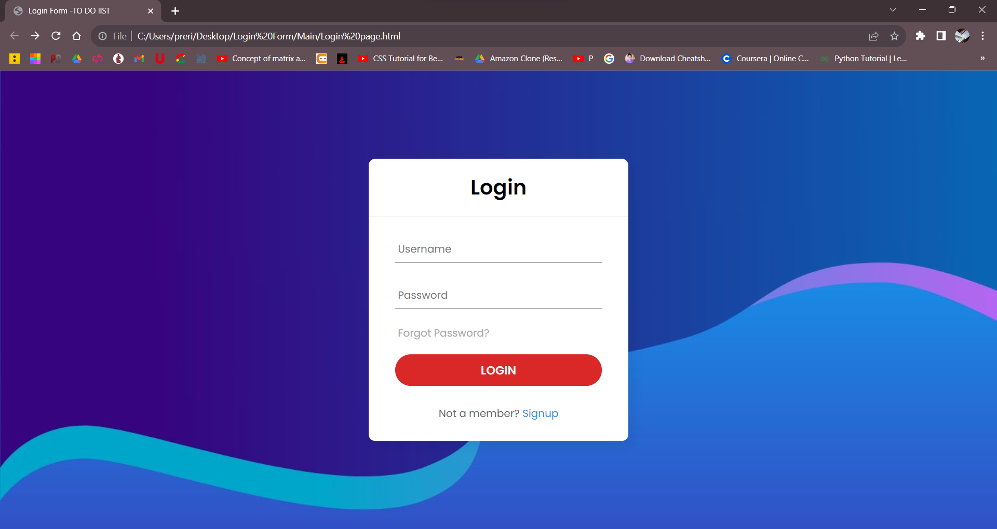
Project Highlights
Progress of the project:

Slide 8


Slide 9
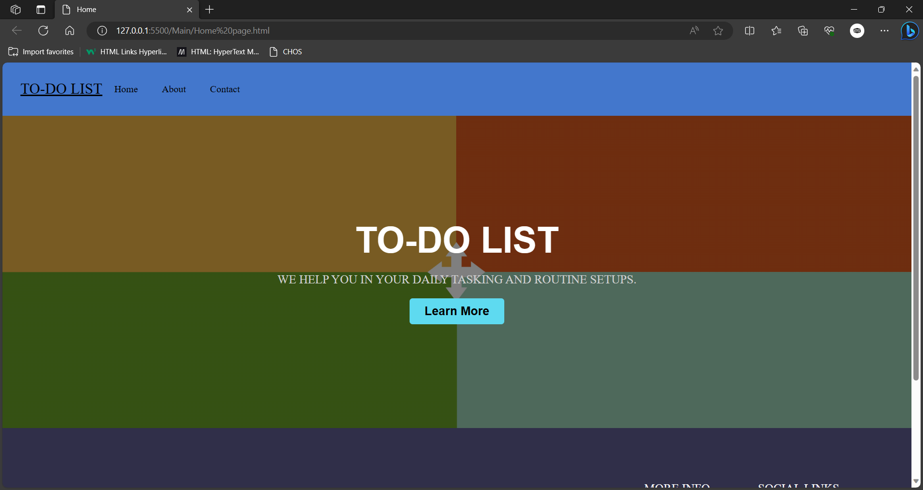

Slide 10
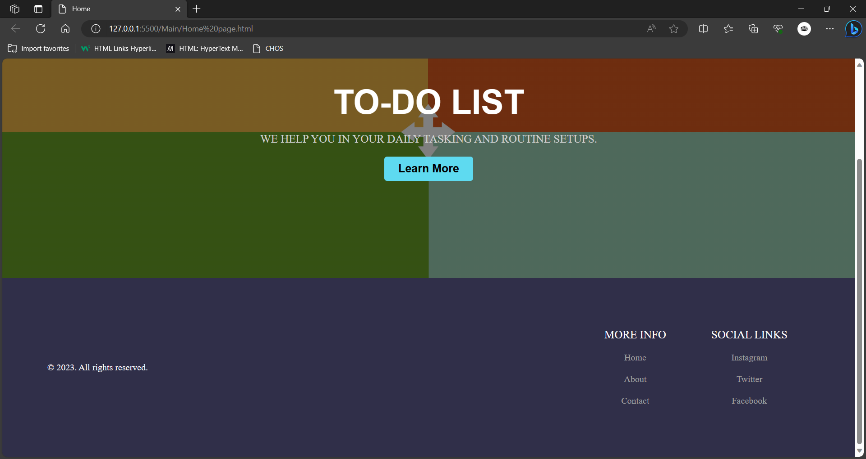

Slide 11
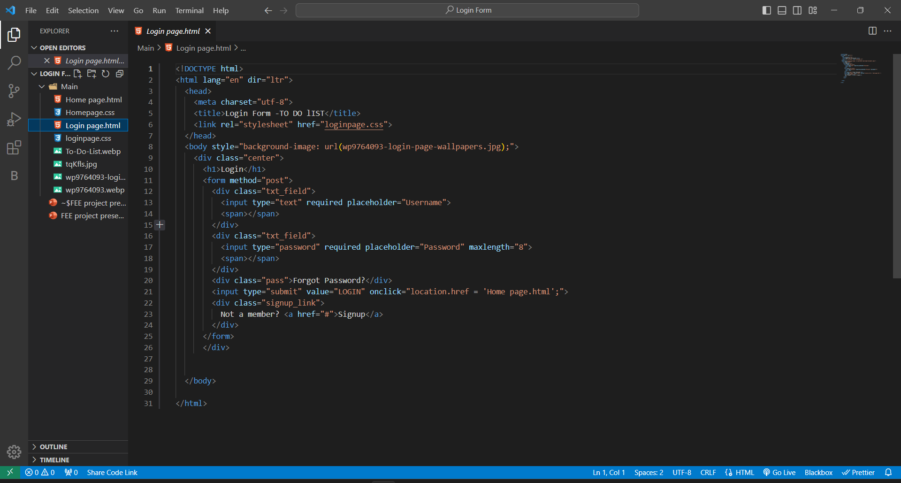
HTML CODE- LOGIN PAGE

Slide 12
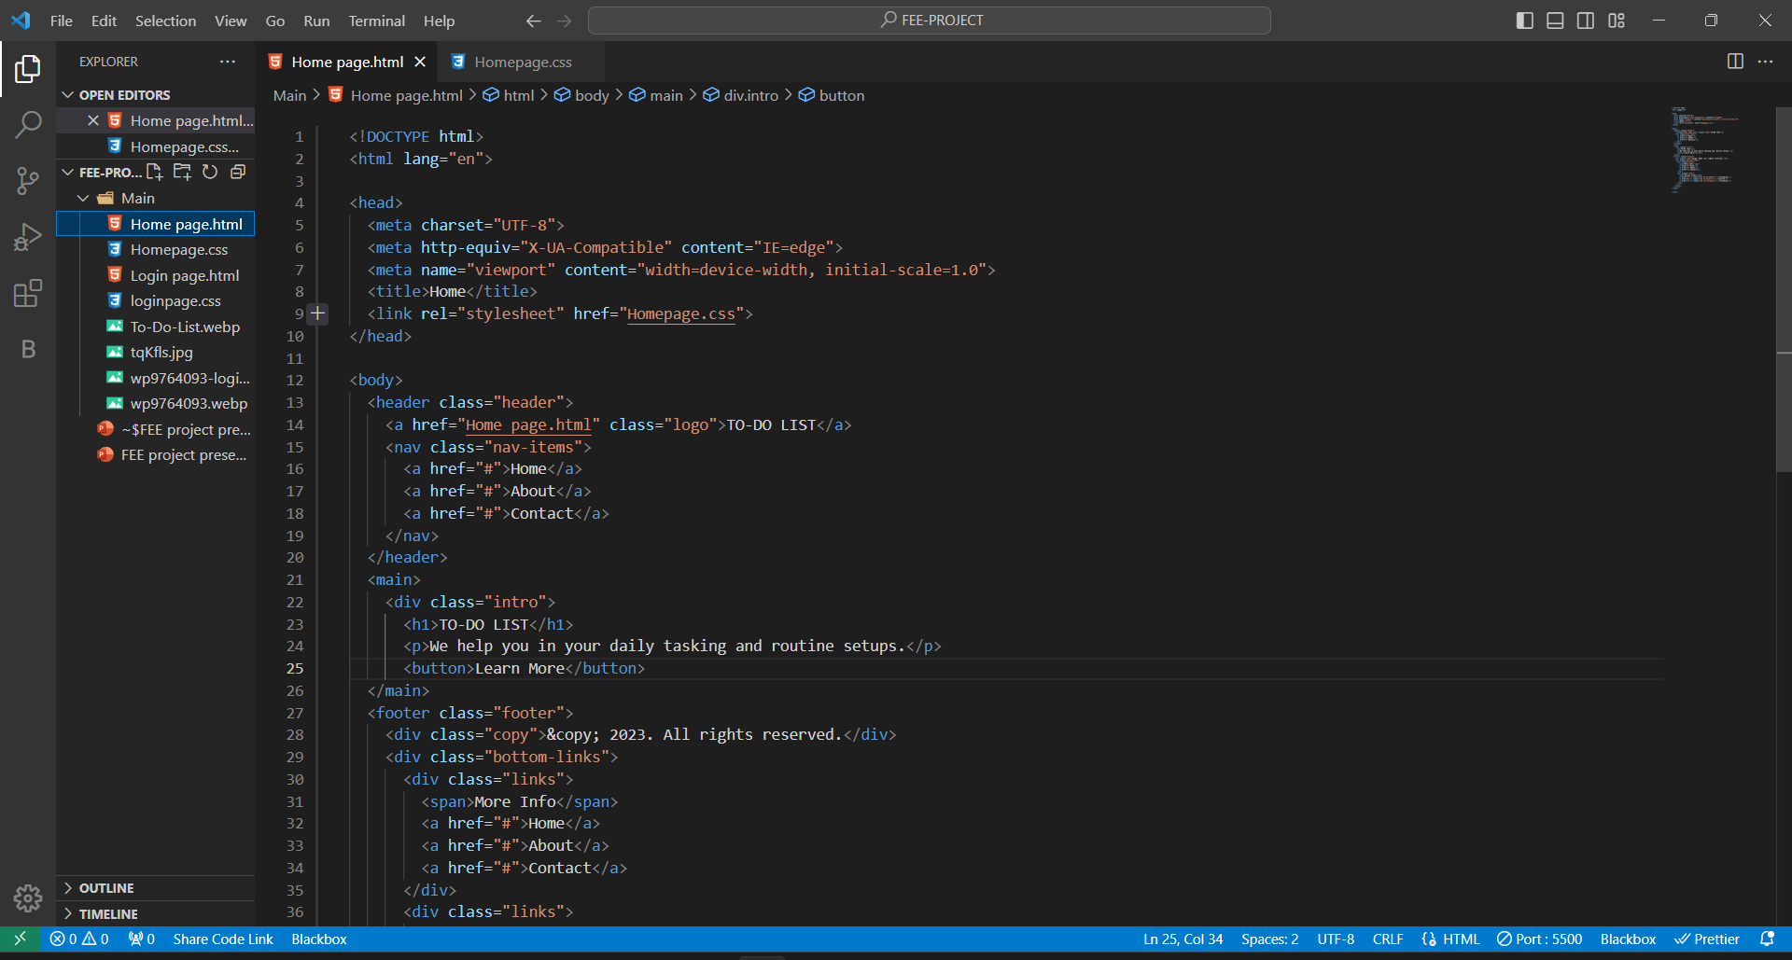
HTML CODE- HOME PAGE

Slide 13
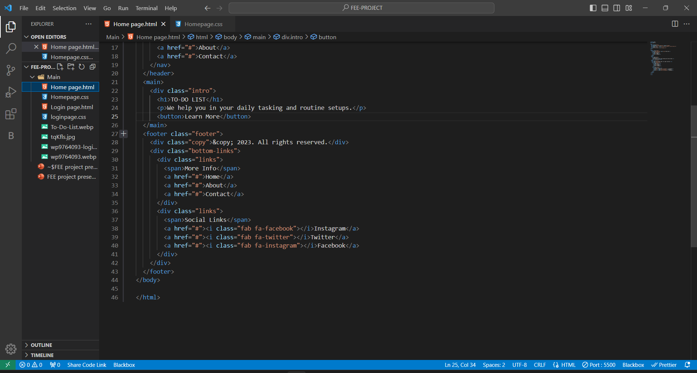

Slide 14
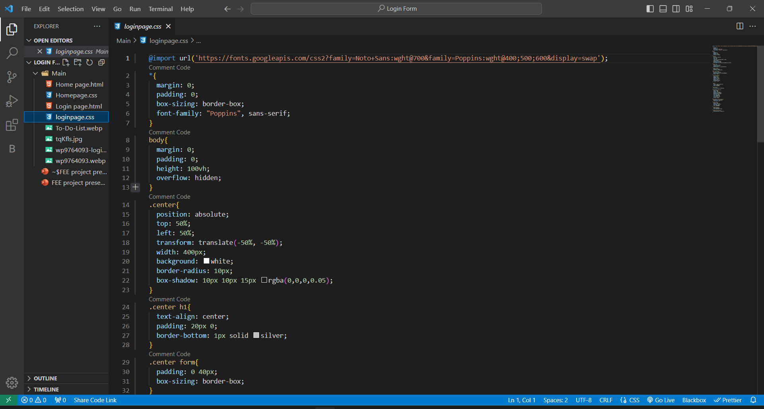
CSS STYLESHEET – LOGIN PAGE

Slide 15
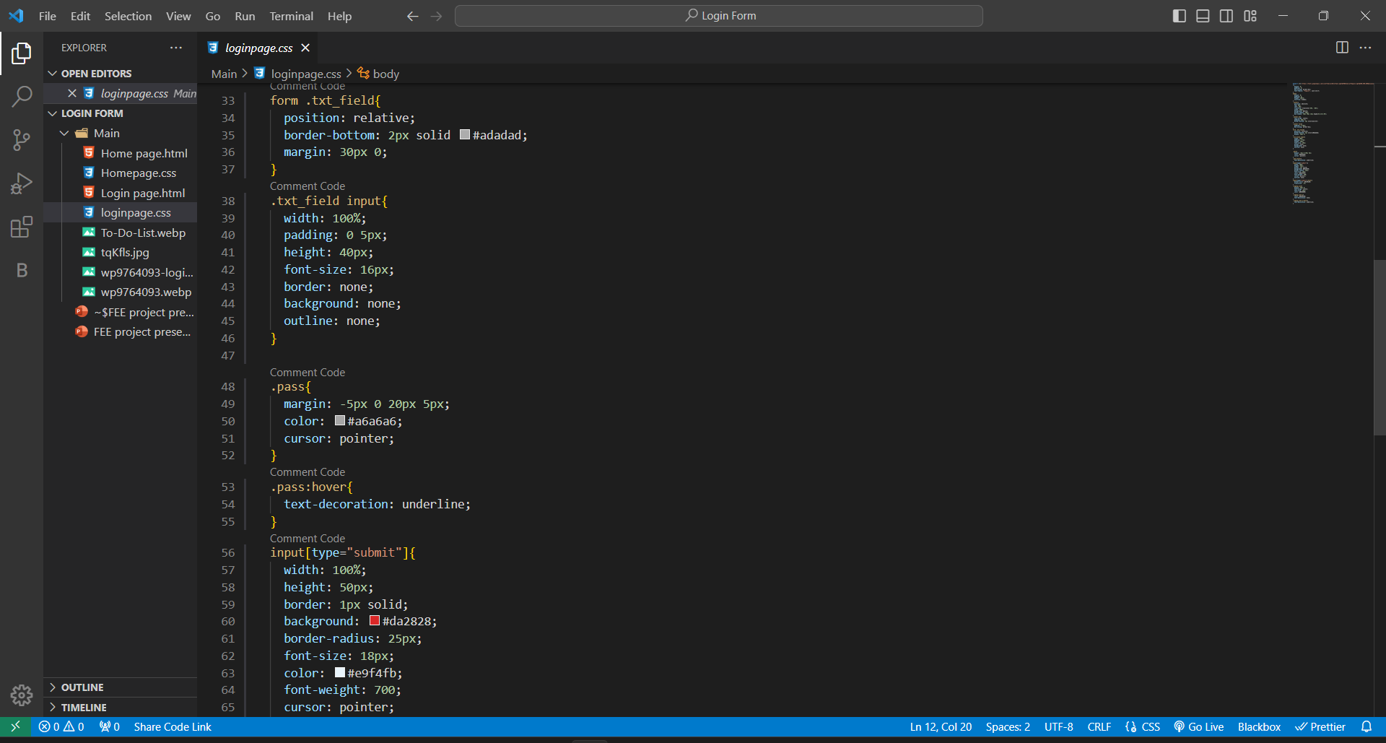

Slide 16
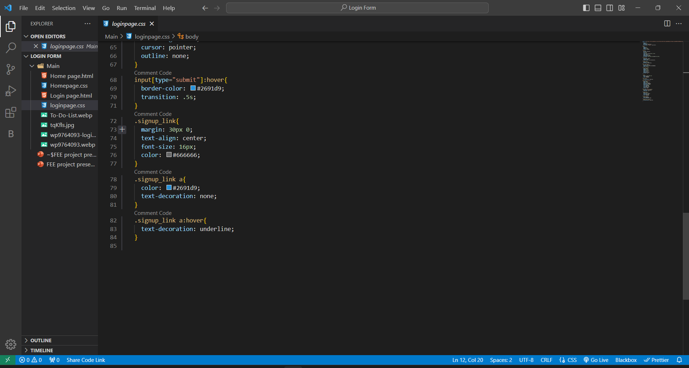

Slide 17
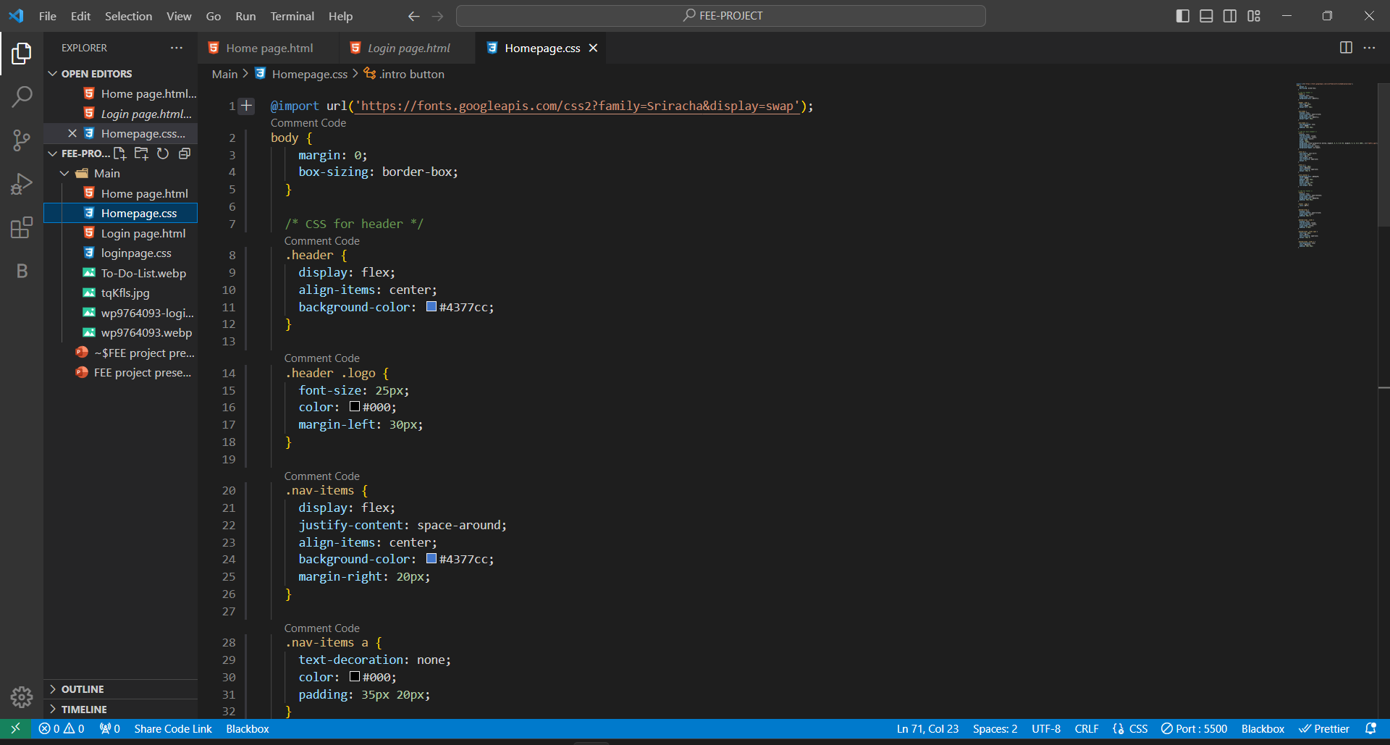
CSS STYLESHEET - HOME PAGE

Slide 18
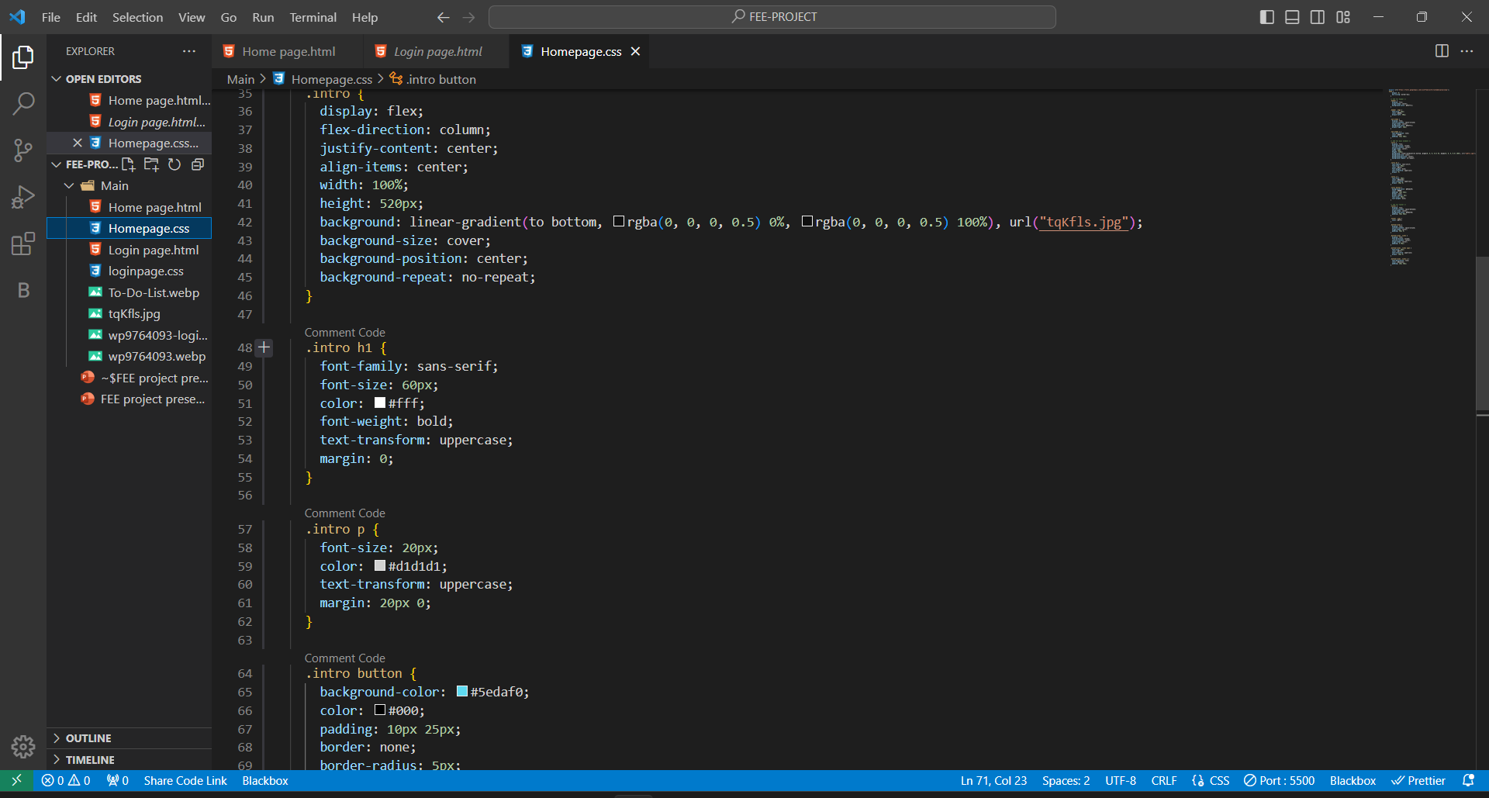

Slide 19
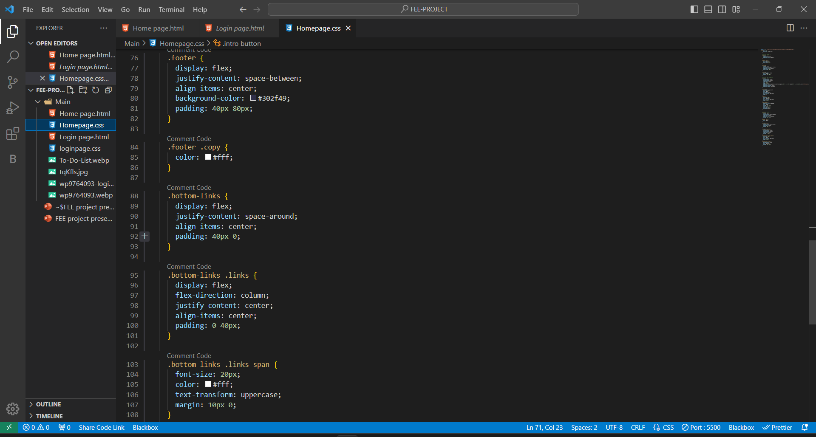

Slide 20
Conclusion
Note Why Each To-Do on Your List Is Important.
Create a To-Do List for Each Week or Each Day makes life easier.
Breaking Large To-Dos Down Into Smaller To-Dos makes the work easier.
One of the most important being much better time management.
Making a To-do List decreases work-related stress and anxiety.

Slide 21
References/Links used
Youtube - @tutorials
https://www.meistertask.com/blog/how-to-write-a-better-to-do-list-and-get-more-done/
https://github.com/dumbmety/todo-list

Slide 22


